Slide 1
Upgrading from AngularJS 1 to Angular 2+
Jake Adams

Slide 2
About Me
Jake Adams
Father / Husband
Senior Software Architect - Thompson Coburn LLP
twitter - @jacobladams
http://github.com/jacobladams

Slide 3
Overview
Setup
Preping for Migration
Migrating using ngUpgrade
More

Slide 4
Vocabulary
vocabulary
angularjs/angular
upgrade/update/migration/etc.

Slide 5
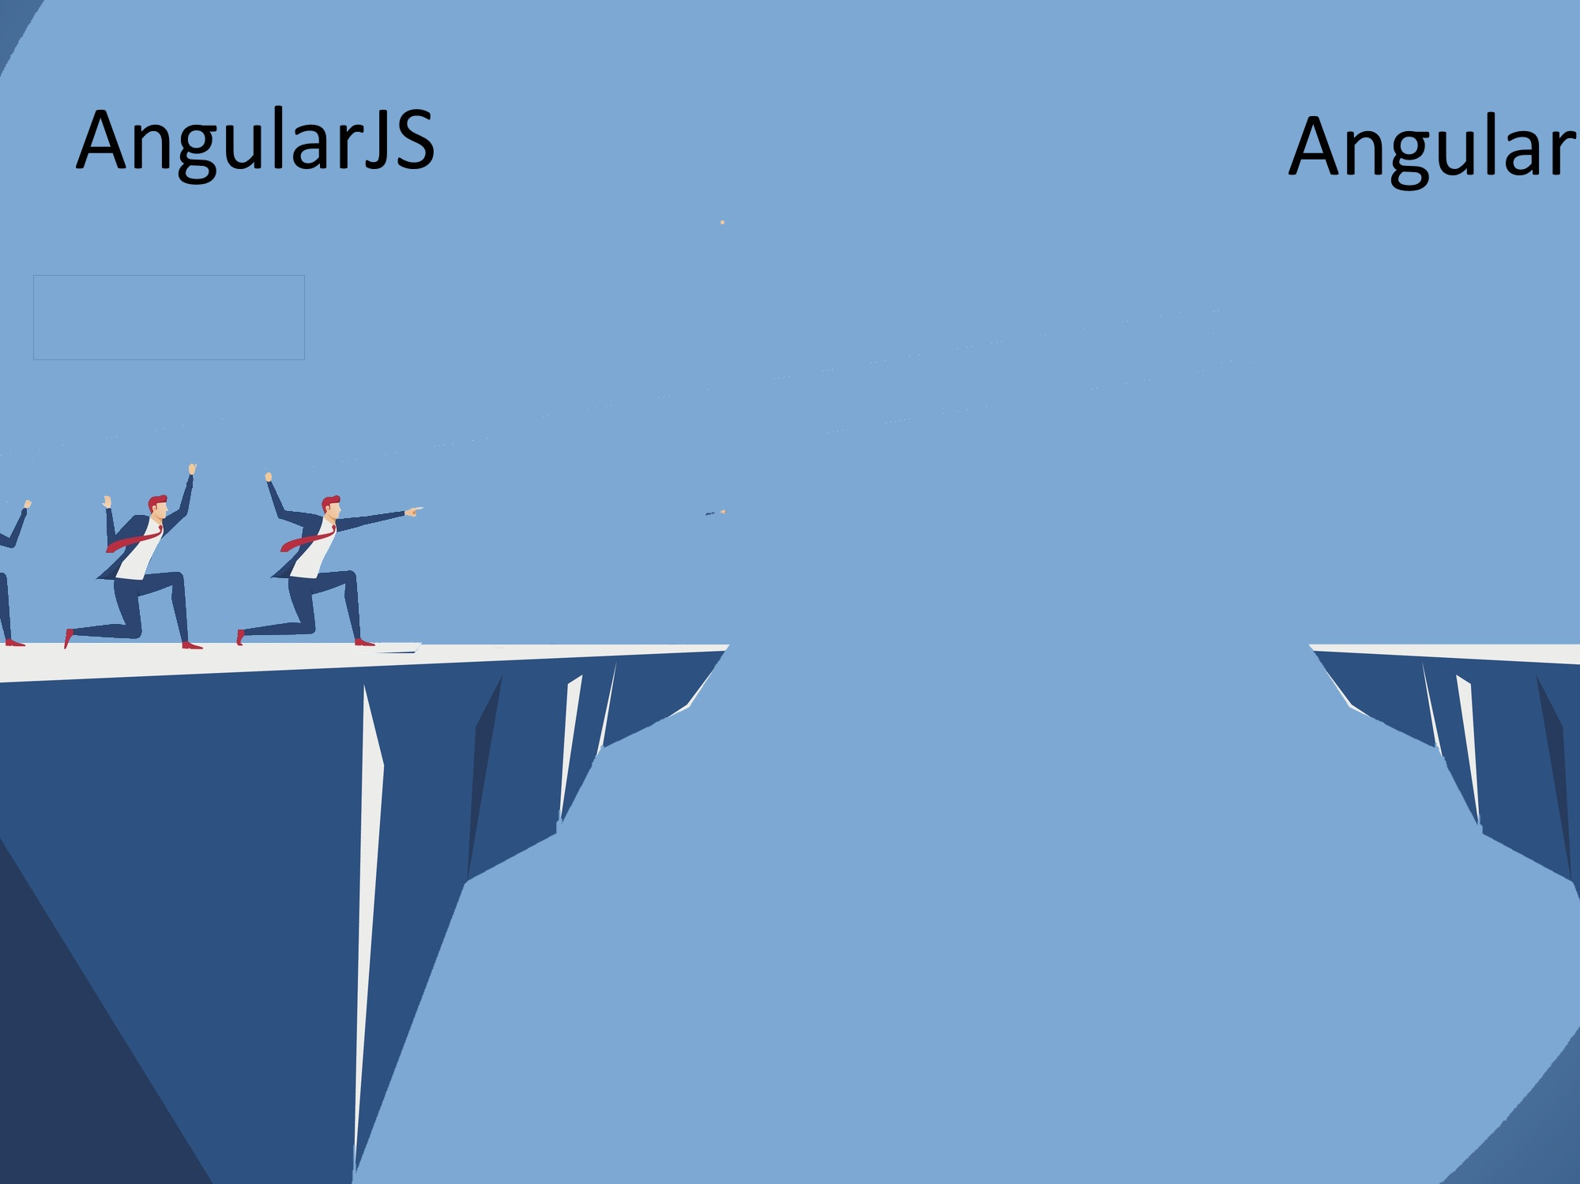

Slide 6
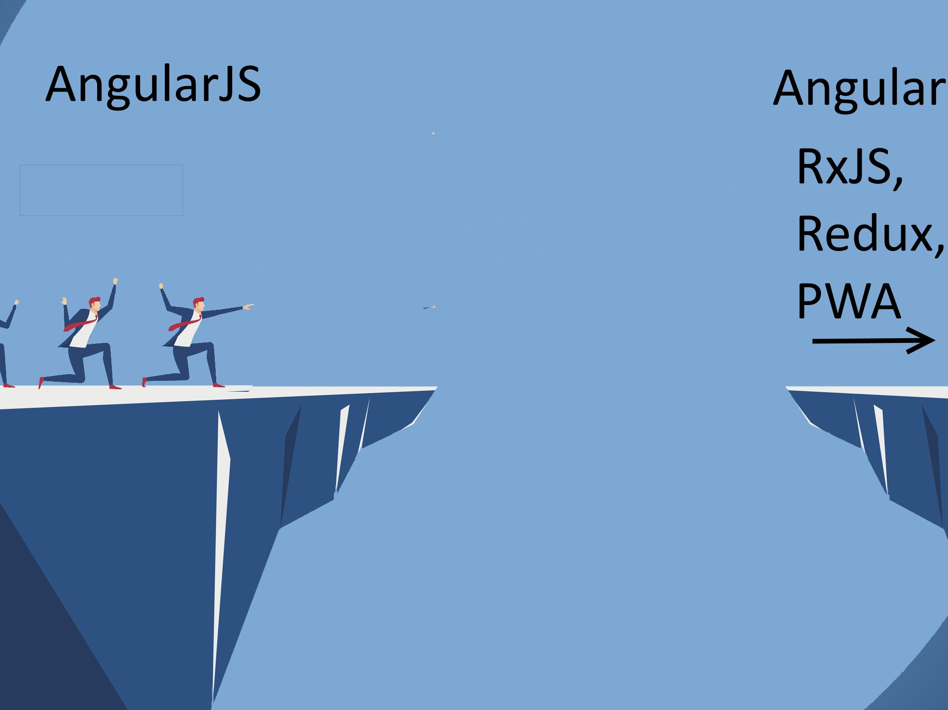

Slide 7
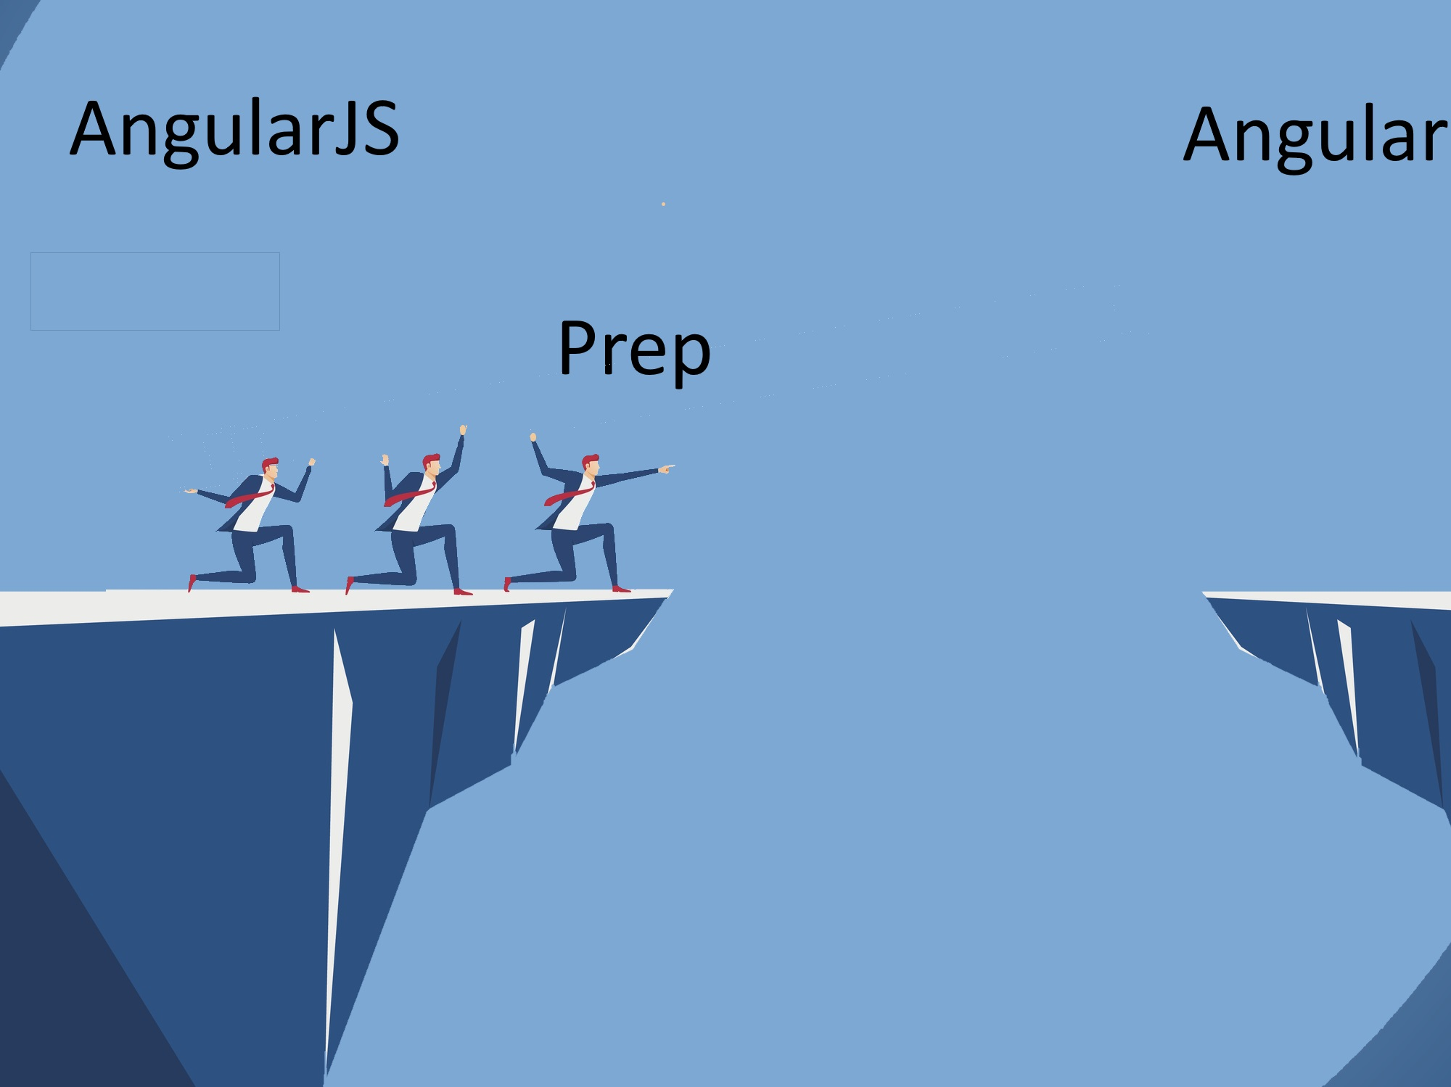

Slide 8
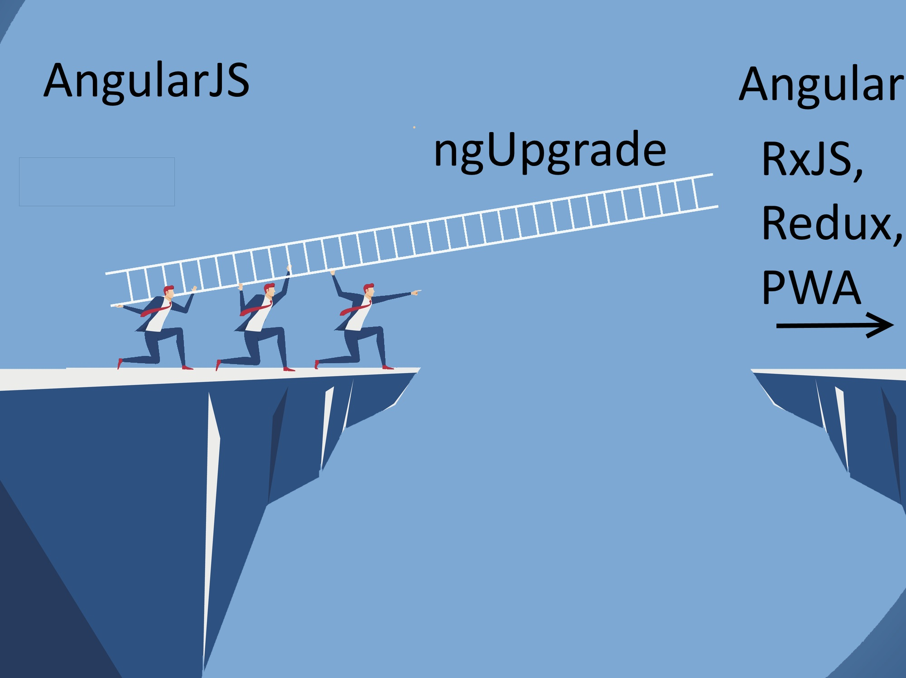

Slide 9
Why Upgrade
keep system up
reduce risk
steady upgrade

Slide 10
But I Don’t Want To!

Slide 11
Option #1: Stay on Angular JS 1.X

Slide 12
Option #2: Go to Another Framework
React
Vue
Ember
Aurelia
Knockout
Hyperapp
Polymer
Backbone

Slide 13
Ok, fine. I’ll upgrade

Slide 14
Demo Architecture

Slide 15
Further Steps
RxJS
Redux
Lazy Loading
Progressive Web App (PWA)

Slide 16
Additional Resources / Questions
Pluralsight couses
https://angular.io/guide/upgrade#bootstrapping-hybrid-applications
https://dormoshe.io/articles/angular-v4-hybrid-upgrade-application-2
Others

